Slide 1
Car Accident Severity

Slide 2
Introduction
Seattle, also known as the Emerald city, is Washington State’s largest city, with home to a large tech industry with Microsoft and Amazon headquartered in its metropolitan area. As of 2020, it has a total metro area population of 3.4 million (www.macrotrends.net). The total number of personal
Vehicles in Seattle in the year 2016 hit a new high of nearly 444,000 vehicles. In one South Lake Union census tract, the car population has more than doubled since 2010 (www.seattletimes.com). The
Increase in car ownership rates can lead to higher numbers of accidents on the road because of a simple probability. Worldwide, approximately 1.35 million people die in road crashes each year, on average 3,700 people lose their lives every day on the roads and an additional 20-50 million suffer non-fatal injuries, often resulting in long-term disabilities.

Slide 3
Problem
The world as a whole suffers due to car accidents, including the USA. National Highway Traffic Safety Administration of the USA suggests that the economical and societal harm from car accidents can cost up to $871 billion in a single year. According to 2017 WSDOT data, a car accident occurs every 4 minutes and a person dies due to a car crash every 20 hours in the state of Washington while Fatal crashes went from 508 in 2016 to 525 in 2017, resulting in the death of 555 people. The project aims to predict how severity of accidents can be reduced based on a few factors.

Slide 4
Data
There are a lot of problems with the data set keeping in mind that this is a machine learning project which uses classification to predict a categorical variable. The dataset has total observations of 194673 with variation in number of observations for every feature. First of all, the total dataset was high variation in the lengths of almost every column of the dataset. The dataset had a lot of empty columns which could have been beneficial had the data been present there. These columns included pedestrian granted way or not, segment lane key, cross walk key and hit parked car.

Slide 5
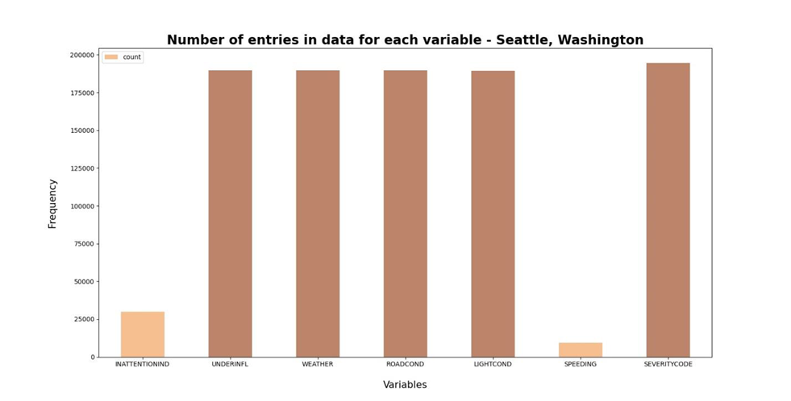
Data

Slide 6
Future Selection

Slide 7
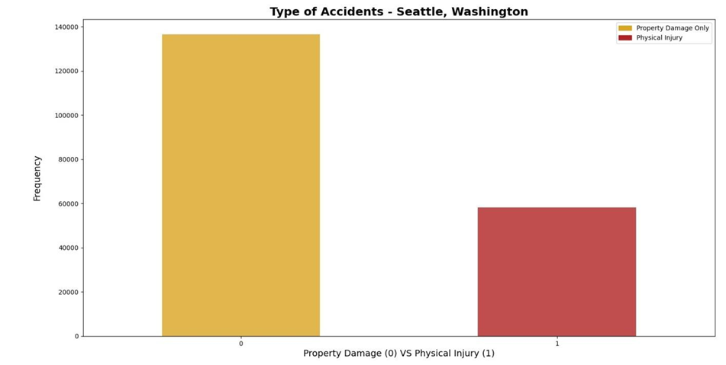
Exploratory Analysis

Slide 8
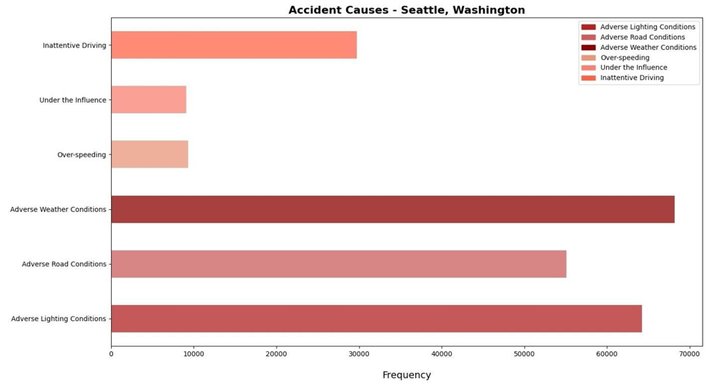
Exploratory Analysis

Slide 9
Machine Learning
The machine learning models used are Logistic Regression, Decision Tree Analysis and k-Nearest Neighbor. Logistic regression is a statistical model that in its basic form uses a logistic function to model a binary dependent variable. The Decision Tree Analysis breaks down a data set into smaller subsets while at the same time an associated decision tree is incrementally developed. The final result is a tree with decision nodes and leaf nodes. K nearest neighbors is a simple algorithm that stores all available cases and classifies new cases based on a similarity measure (based on distance). The reason why Decision Tree Analysis, Logistic Regression and k-Nearest Neighbor classification methods were chosen is because the Support Vector Machine (SVM) model is inaccurate for large data sets, while this data set has more than 180,000 rows filled with data. Furthermore, SVM works best with dataset filled with text and images.

Slide 10
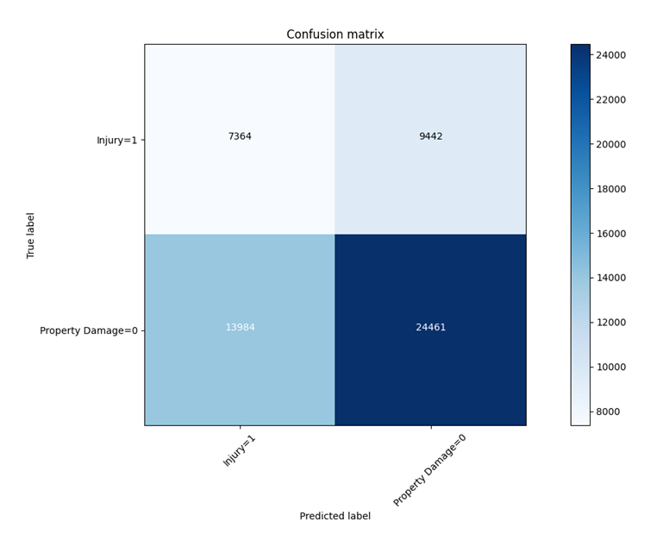
Decision Tree

Slide 11
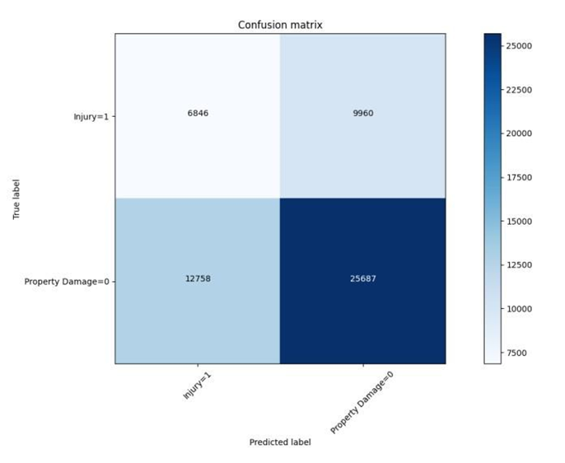
Logistic Regression

Slide 12
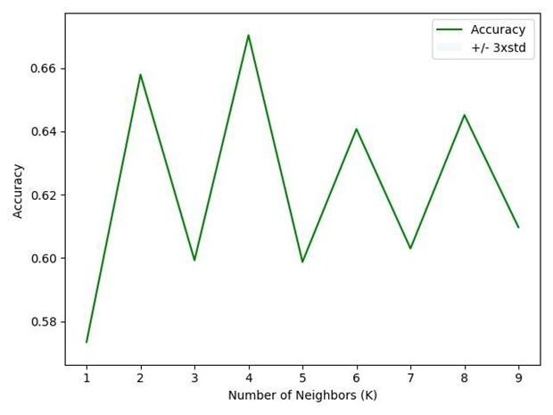
KNN

Slide 13
Discussion

Slide 14
F1 Score
f1-score is a measure of accuracy of the model, which is the harmonic mean of the model’s precision and recall. Perfect precision and recall is shown by the f1-score as 1, which is the highest value for the f1-score, whereas the lowest possible value is 0 which means that either precision or recall is 0. The f1-score shown above is the average of the individual f1-scores of the two elements of the target variable i.e. Property Damage and Injury. When comparing the f1-scores of the three models, we can see that k-Nearest Neighbor has the highest f1-score meaning that it has a higher precision and recall of the other two models. Whereas, the Decision Tree model’s f1-score is the lowest of the three at 0.56. Lastly, the f1-score of the Logistic Regression is at 0.60 which can be considered as an above average score. However, the average f1-score doesn’t depict the true picture of the models accuracy because of the different precision and recall of the model for both the elements of the target variable. Hence, it is biased more towards the precision and recall of Property Damage due to its weightage in the model.

Slide 15
Presision
Precision refers to the percentage of results which are relevant, in simpler terms it can be seen as how many of the selected items from the model are relevant. Mathematically, it is calculated by dividing true positives by true positive and false positive. The highest precision for Property Damage is for Logistic Regression, whereas for Injury it is the Decision Tree. The Precision is calculated individually above in order to understand how accurate the model is at predicting Property Damage and Injury individually. For the Decision Tree the precision of 0 is 0.64 and for 1 it is 0.44 which is fairly good. As for the Logistic Regression model, for 0 it is at 0.72 and for 1 it is 0.35. Lastly, for the k-Nearest Neighbor at 0 it is 0.93, which is highly accurate, however for 1 it is 0.08, extremely low. In terms of precision, the best performing model is the decision tree.

Slide 16
Conclusion
In retrospect, when comparing these scores to the benchmarks within the industry, it can be seen that they perform well but not as good as the benchmarks. These models could have performed better if a few more things were present and possible.
A balanced dataset for the target variable
More instances recorded of all the accidents taken place in Seattle, Washington
Less missing values within the dataset for variables such as Speeding and Under the influence
More factors, such as precautionary measures taken when driving, etc.

